Slide 1
DAI Cohort #2 Final Project
South German Credit
Predicting Good/Bad Credit Risk

Slide 2
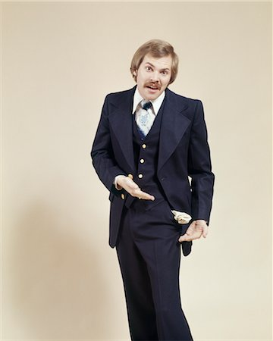

Data
700 good and 300 bad credits with 20 predictor variables. Data from 1973 to 1975.

Slide 3
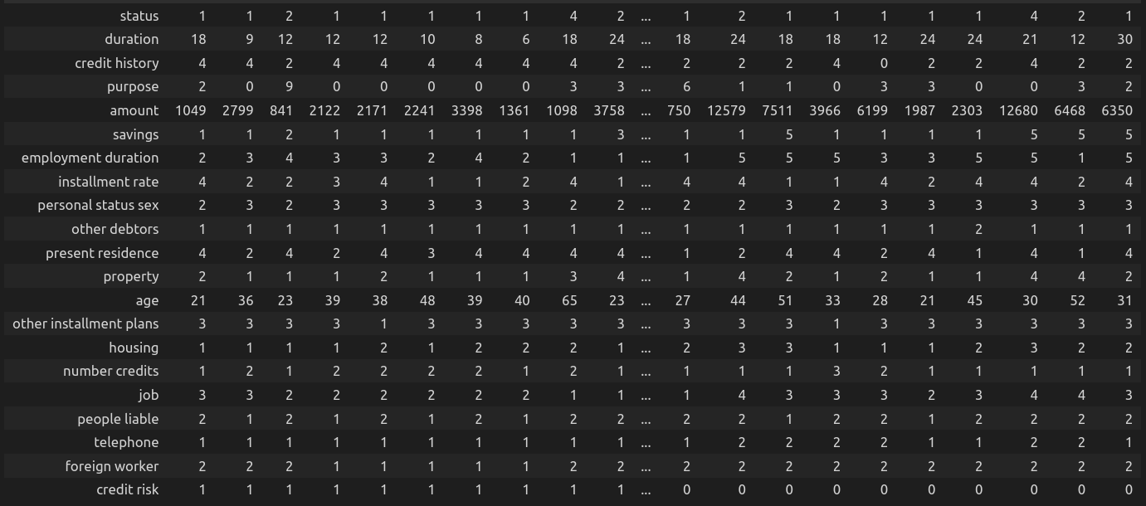
A look at the data

Slide 4

Prediction Model
Predict whether a person is in “bad” credit risk rating.
Example of use: bank deciding whether or not to deny a loan request
Higher relationship factors for good credit risk: age and having a home telephone line.

Slide 5
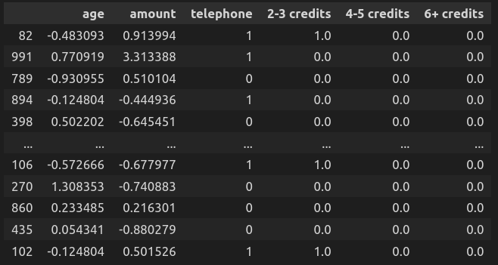
A look at the data used

Slide 6
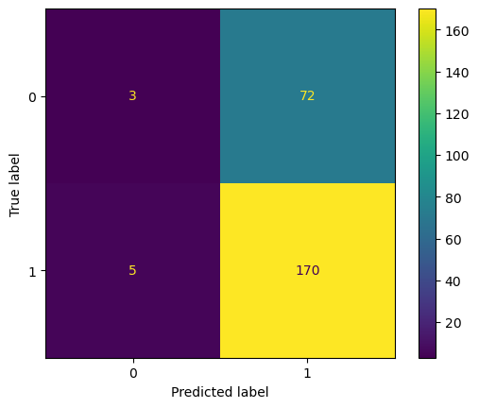
Confusion Matrix (0.5 Threshold)
Bad Credit
Good Credit
False
True

Slide 7
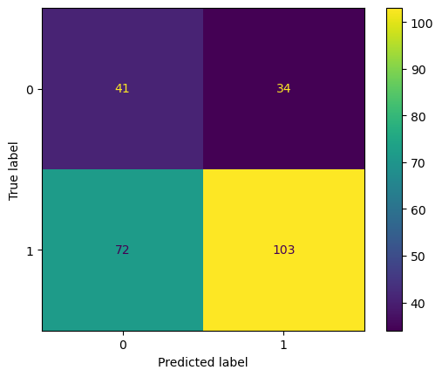
Confusion Matrix (0.69 Threshold)
Bad Credit
Good Credit
False
True

Slide 8
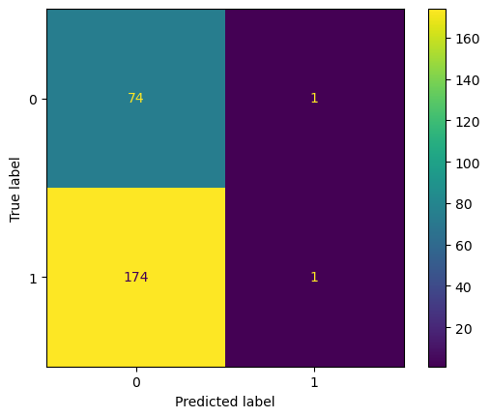
Confusion Matrix (0.85 Threshold)
Bad Credit
Good Credit
False
True

Slide 9
Way forward
Given more time my model can be refined to add more factors giving a more accurate prediction of Credit Risk of an individual.

Slide 10
Sources
UCI Machine Learning Repository
https://archive.ics.uci.edu/ml/datasets/South+German+Credit+%28UPDATE%29
Citation Request:
Grömping, U. (2019). South German Credit Data: Correcting a Widely Used Data Set. Report 4/2019, Reports in Mathematics, Physics and Chemistry, Department II, Beuth University of Applied Sciences Berlin.Grömping, U. (2019). South German Credit Data: Correcting a Widely Used Data Set. Report 4/2019, Reports in Mathematics, Physics and Chemistry, Department II, Beuth University of Applied Sciences Berlin.

Slide 11
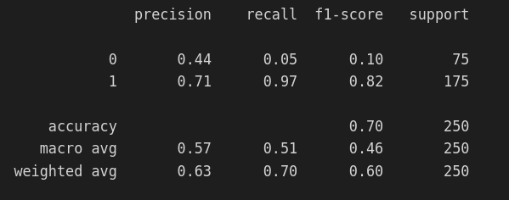
Appendix 1 (0.5 thresh.)
0 = “bad” 1= “good”

Slide 12
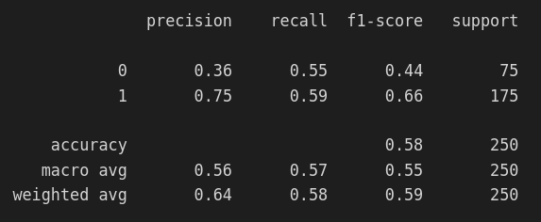
Appendix 1 cont. (0.69 thresh.)

Slide 13
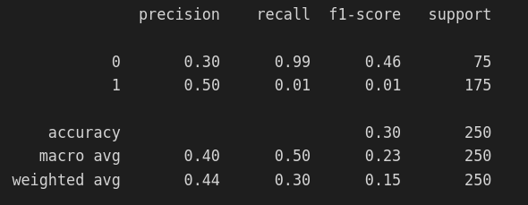
Appendix 1 cont. (0.85 thresh.)

Slide 14
Appendix 2
Coefficients
Age - 0.19281298
Amount of Debt - -0.36273262
Having a Home Phone – 0.42930563
Number of Active Debts :
2-3 – 0.25889471
4-5 – 0.02802401
6+ - -0.44472538

Slide 15
Appendix 3
verw = purpose
0 : others
1 : car (new)
2 : car (used)
3 : furniture/equipment
4 : radio/television
5 : domestic appliances
6 : repairs
7 : education
8 : vacation
9 : retraining
10 : business
hoehe = amount
laufkont = status
1 : no checking account
2 : ... < 0 DM
3 : 0<= ... < 200 DM
4 : ... >= 200 DM / salary for at least 1 year
aufzeit = duration
moral = credit_history
0 : delay in paying off in the past
1 : critical account/other credits elsewhere
2 : no credits taken/all credits paid back duly
3 : existing credits paid back duly till now
4 : all credits at this bank paid back duly

Slide 16
Appendix 3 cont.
sparkont = savings
1 : unknown/no savings account
2 : ... < 100 DM
3 : 100 <= ... < 500 DM
4 : 500 <= ... < 1000 DM
5 : ... >= 1000 DM
beszeit = employment_duration
1 : unemployed
2 : < 1 yr
3 : 1 <= ... < 4 yrs
4 : 4 <= ... < 7 yrs
5 : >= 7 yrs
rate = installment_rate
1 : >= 35
2 : 25 <= ... < 35
3 : 20 <= ... < 25
4 : < 20
famges = personal_status_sex
1 : male : divorced/separated
2 : female : non-single or male : single
3 : male : married/widowed
4 : female : single
buerge = other_debtors
1 : none
2 : co-applicant
3 : guarantor
wohnzeit = present_residence
1 : < 1 yr
2 : 1 <= ... < 4 yrs
3 : 4 <= ... < 7 yrs
4 : >= 7 yrs

Slide 17
Appendix 3 cont.
verm = property
1 : unknown / no property
2 : car or other
3 : building soc. savings agr./life insurance
4 : real estate
alter = age
weitkred = other_installment_plans
1 : bank
2 : stores
3 : none
wohn = housing
1 : for free
2 : rent
3 : own
bishkred = number_credits
1 : 1
2 : 2-3
3 : 4-5
4 : >= 6
beruf = job
1 : unemployed/unskilled - non-resident
2 : unskilled - resident
3 : skilled employee/official
4 : manager/self-employed/
highly\ qualified employee
pers = people_liable
1 : 3 or more
2 : 0 to 2

Slide 18
Appendix 3 cont.
telef = telephone
1 : no
2 : yes (under customer name)
gastarb = foreign_worker
1 : yes
2 : no
kredit = credit_risk
0 : bad
1 : good

